Slide 1
ETRSS-1 Interface between Satellite System and Ground System for Data Reception/Processing
DFH SATELLITE CO.,LTD
February.2019

Slide 2
Objectives
After finishing the learning of this chapter, participants can :
Know the functions and requirements of data reception and processing.
Know the workflow of DTS.
Know how to use the satellite data.
THIS DOCUMENT CONTAINS PROPRIETARY INFORMATION OF CHINA ACADEMY OF SPACE TECHNOLOGY, AND MAY NOT BE REPRODUCED, COPIED, DISCLOSED, UTILIZED, PLACED OR TRANSMITTED ON INTERNET, IN WHOLE OR IN PART, WITHOUT PRIOR WRITTEN AUTHORIZATION.

Slide 3
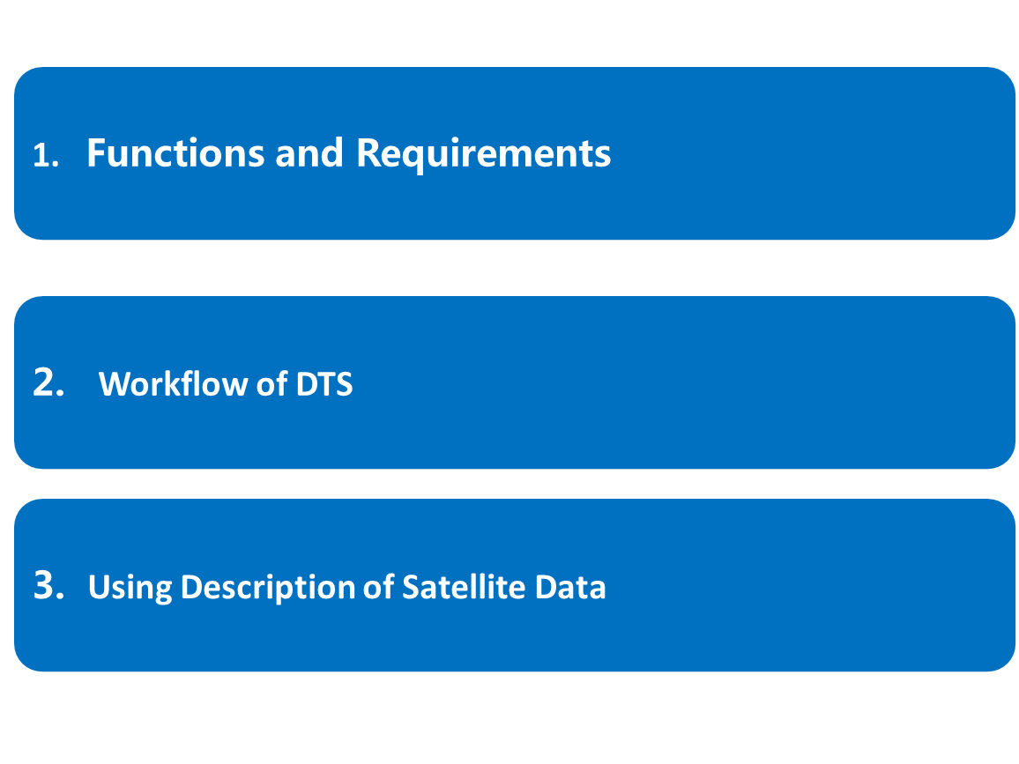
Content
THIS DOCUMENT CONTAINS PROPRIETARY INFORMATION OF CHINA ACADEMY OF SPACE TECHNOLOGY, AND MAY NOT BE REPRODUCED, COPIED, DISCLOSED, UTILIZED, PLACED OR TRANSMITTED ON INTERNET, IN WHOLE OR IN PART, WITHOUT PRIOR WRITTEN AUTHORIZATION.

Slide 4
Words to Know
Acronyms | Definition
RF | Radio Frequency
EIRP | Equivalent Isotropic Radiated Power
CCD | Charge-Coupled Device
QPSK | Quadrature Phase Shift Keying
PCM | Pulse Code Modulation
BPSK | Binary Phase Shift Keying
PM | Phase Modulation
DTS | Data Transmission Subsystem
dB | Decibel
MTFC | Modulation Transferring Function Compensation
CAN | Control Area Network
DHS | Data Handling System
GPS | Global Positioning System
GSD | Ground Sample Distance
WGS84 | World Geodetic System 84
THIS DOCUMENT CONTAINS PROPRIETARY INFORMATION OF CHINA ACADEMY OF SPACE TECHNOLOGY, AND MAY NOT BE REPRODUCED, COPIED, DISCLOSED, UTILIZED, PLACED OR TRANSMITTED ON INTERNET, IN WHOLE OR IN PART, WITHOUT PRIOR WRITTEN AUTHORIZATION.

Slide 5
Words to Know
Acronyms | Definition
UTC | Universal Time Code
AOCS | Attitude and Orbit Control Subsystem
MS | Multispectral Camera
HEX | Hexadecimal
DEC | Decimal
TSM | Telemetry Storage Module
SNR | Signal-Noise Ratio
THIS DOCUMENT CONTAINS PROPRIETARY INFORMATION OF CHINA ACADEMY OF SPACE TECHNOLOGY, AND MAY NOT BE REPRODUCED, COPIED, DISCLOSED, UTILIZED, PLACED OR TRANSMITTED ON INTERNET, IN WHOLE OR IN PART, WITHOUT PRIOR WRITTEN AUTHORIZATION.

Slide 6
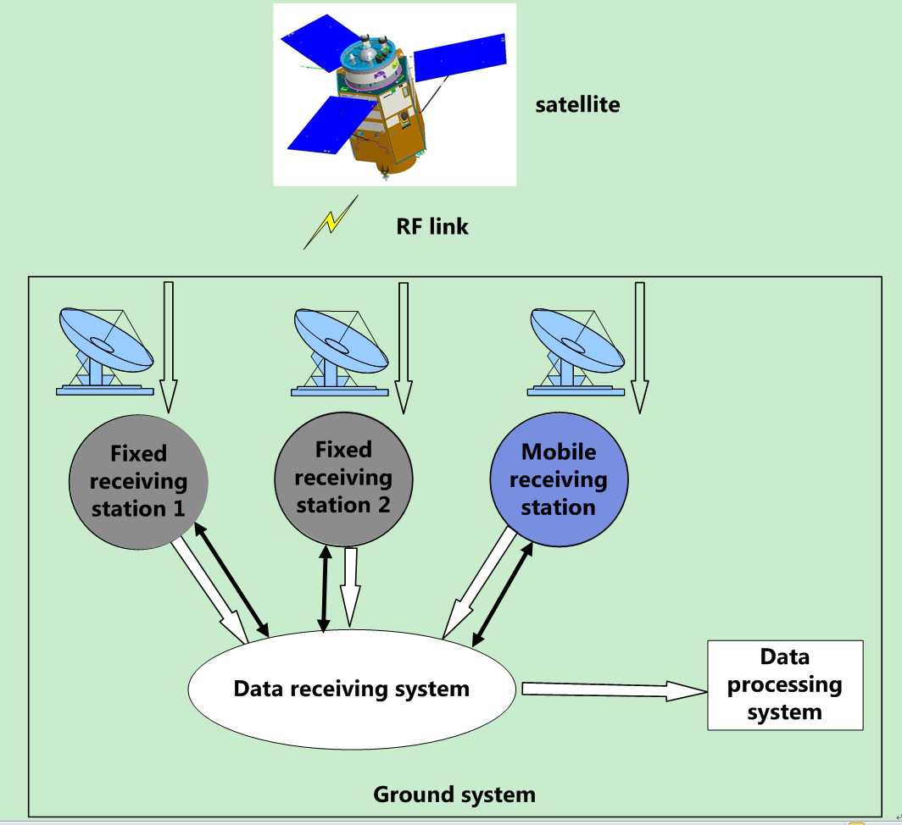
1 Functions and Requirements
1.1 Functions
The ground system can communicate with satellite via RF link and provide the following two functions:
receiving the image rawdata and the telemetry data from the satellite and transferring them to the Ground processing system.
processing the image rawdata and generating image product.
THIS DOCUMENT CONTAINS PROPRIETARY INFORMATION OF CHINA ACADEMY OF SPACE TECHNOLOGY, AND MAY NOT BE REPRODUCED, COPIED, DISCLOSED, UTILIZED, PLACED OR TRANSMITTED ON INTERNET, IN WHOLE OR IN PART, WITHOUT PRIOR WRITTEN AUTHORIZATION.
Notes:
1) Ground receiving system is responsible for receiving the image rawdata and the telemetry data downloading from the satellite and transferring them to the Ground processing system.
2) Ground processing system is responsible for processing the image rawdata and generating image product.

Slide 7
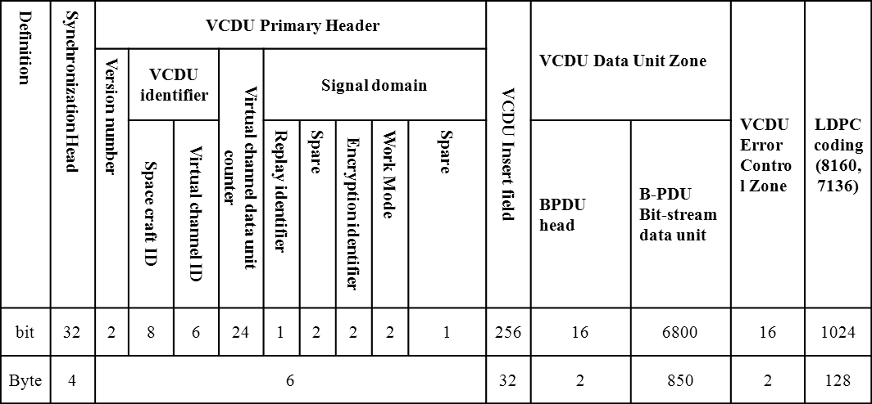
Data Handling - DTS Data Format
    1.1 Data format of ETRSS-1
Encryption
CRC
Scrambling / LDPC
PAGE <number>
THIS DOCUMENT CONTAINS PROPRIETARY INFORMATION OF CHINA ACADEMY OF SPACE TECHNOLOGY, AND MAY NOT BE REPRODUCED, COPIED, DISCLOSED, UTILIZED, PLACED OR TRANSMITTED ON INTERNET, IN WHOLE OR IN PART, WITHOUT PRIOR WRITTEN AUTHORIZATION.

Slide 8
1 Functions and Requirements
1.2 Requirements of data reception
Item | Requirements
Frequency | X-band: 8.0GHz～9.0GHz (receiving)
Antenna G/T value | G/T: (in clear sky, 23℃, at 5°EL) X-band: G/T≥27 dB/;
Modulation | Data channel: QPSK
Decoding mode | Low Density Parity Check Code (LDPC) (8176，6180)
Tracking requirements | Cover Range: -70°~+70°
Polarization | RHCP polarization
Down-link rate | 100Mbps
THIS DOCUMENT CONTAINS PROPRIETARY INFORMATION OF CHINA ACADEMY OF SPACE TECHNOLOGY, AND MAY NOT BE REPRODUCED, COPIED, DISCLOSED, UTILIZED, PLACED OR TRANSMITTED ON INTERNET, IN WHOLE OR IN PART, WITHOUT PRIOR WRITTEN AUTHORIZATION.

Slide 9
1 Functions and Requirements
1.3 Requirements of data processing
After reception, data processing system can process the image raw data and generate the image product in terms of satellite auxiliary data and lab calibration data.
MTFC processing in terms of MTF curve;
relative radiometric correction in terms of lab calibration data;
image stitching in terms of the object feature in the overlap zone of B1/B2/B3/B4 MS image;
geometry correction in terms of the calibration data;
THIS DOCUMENT CONTAINS PROPRIETARY INFORMATION OF CHINA ACADEMY OF SPACE TECHNOLOGY, AND MAY NOT BE REPRODUCED, COPIED, DISCLOSED, UTILIZED, PLACED OR TRANSMITTED ON INTERNET, IN WHOLE OR IN PART, WITHOUT PRIOR WRITTEN AUTHORIZATION.

Slide 10
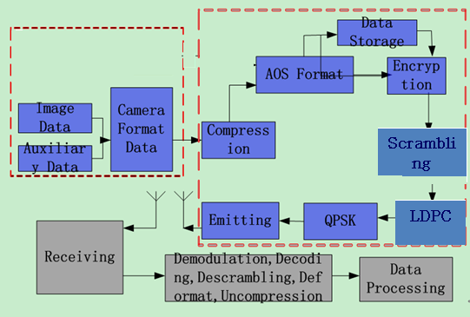
2 Workflow of DTS
After the image data acquired by the Camera Subsystem is sent to Data Transmission Subsystem (DTS), image data :
a) can be compressed, format by the Compressing Coder and Data Processer;
THIS DOCUMENT CONTAINS PROPRIETARY INFORMATION OF CHINA ACADEMY OF SPACE TECHNOLOGY, AND MAY NOT BE REPRODUCED, COPIED, DISCLOSED, UTILIZED, PLACED OR TRANSMITTED ON INTERNET, IN WHOLE OR IN PART, WITHOUT PRIOR WRITTEN AUTHORIZATION.

Slide 11
2 Workflow of DTS
b) can be encoded, scrambled and modulated by the Modulator;
c) can be transferred to the ground receiving station by the Antenna;
d) can also be stored temporally in the disk and then be read and processed by all steps as above in need of transferring to the ground.
THIS DOCUMENT CONTAINS PROPRIETARY INFORMATION OF CHINA ACADEMY OF SPACE TECHNOLOGY, AND MAY NOT BE REPRODUCED, COPIED, DISCLOSED, UTILIZED, PLACED OR TRANSMITTED ON INTERNET, IN WHOLE OR IN PART, WITHOUT PRIOR WRITTEN AUTHORIZATION.

Slide 12
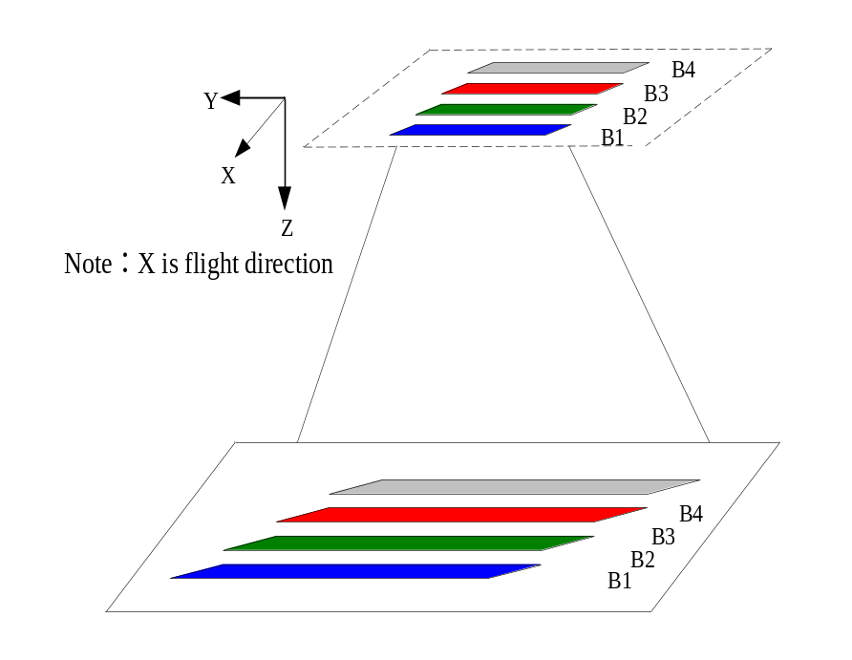
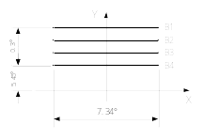
3. Camera Design
3.1 Camera specification requirements
Imaging Geometry relationship
Camera Focal plane
THIS DOCUMENT CONTAINS PROPRIETARY INFORMATION OF CHINA ACADEMY OF SPACE TECHNOLOGY, AND MAY NOT BE REPRODUCED, COPIED, DISCLOSED, UTILIZED, PLACED OR TRANSMITTED ON INTERNET, IN WHOLE OR IN PART, WITHOUT PRIOR WRITTEN AUTHORIZATION.

Slide 13
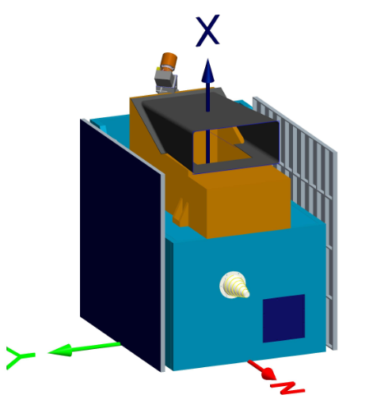
3. Camera Design
3.1 Camera specification requirements
Items | Designed Results
Spectrum | Blue（B1）：0.45μm±0.02μm～0.52μm±0.02μm Green（B2）：0.52μm±0.02μm～0.59μm±0.02μm Red（B3）：0.63μm±0.02μm～0.69μm±0.02μm NIR（B4）：0.77μm±0.02μm～0.89μm±0.02μm
Detector | 6000元，13μm
Focal Length | 608 mm
FOV | ≥7.317°
Relative Distortion | ≤1.5%
Static MTF | ≥0.20@38.5lp/mm
Size | ≤520mm×290mm×285mm
Mass | ≤18kg
Power Consumption | ≤25W(doesn’t include thermal power consumption)
Life | 2 years
THIS DOCUMENT CONTAINS PROPRIETARY INFORMATION OF CHINA ACADEMY OF SPACE TECHNOLOGY, AND MAY NOT BE REPRODUCED, COPIED, DISCLOSED, UTILIZED, PLACED OR TRANSMITTED ON INTERNET, IN WHOLE OR IN PART, WITHOUT PRIOR WRITTEN AUTHORIZATION.

Slide 14

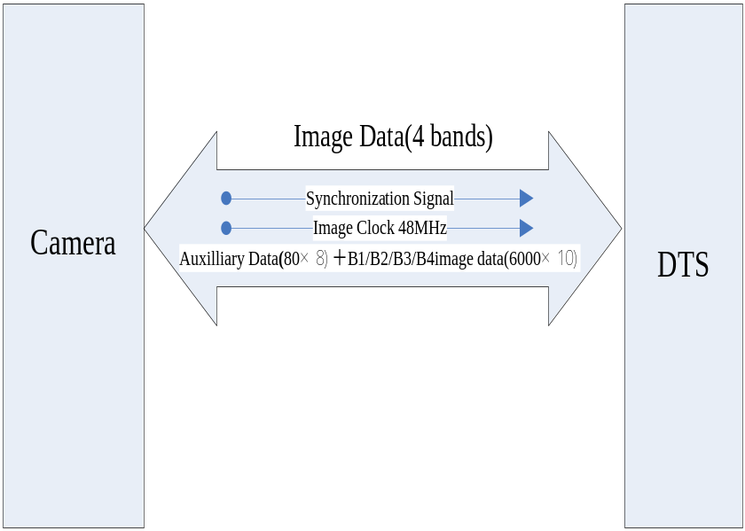
3 How to Use Satellite Data
3.2 Imaging geometry and pixel order
  1 CCD, 4 bands(B1,B2,B3,B4)，4 Output channels
  For each band:
    80 auxilliary data(8 bit)+6000 image data(10 bit)
    1 synchronization signal
    1 clock(48MHz)
  Data Rate: ≤135Mbps
THIS DOCUMENT CONTAINS PROPRIETARY INFORMATION OF CHINA ACADEMY OF SPACE TECHNOLOGY, AND MAY NOT BE REPRODUCED, COPIED, DISCLOSED, UTILIZED, PLACED OR TRANSMITTED ON INTERNET, IN WHOLE OR IN PART, WITHOUT PRIOR WRITTEN AUTHORIZATION.
Notes:
Each TDICCD has 6144 Panchromatic pixels and 1536 multispectral pixels for every spectral. The imaging geometry relation of focal plane, combined by 4 Panchromatic/Multispectral TDICCDs, and ground object is shown in Fig

Slide 15
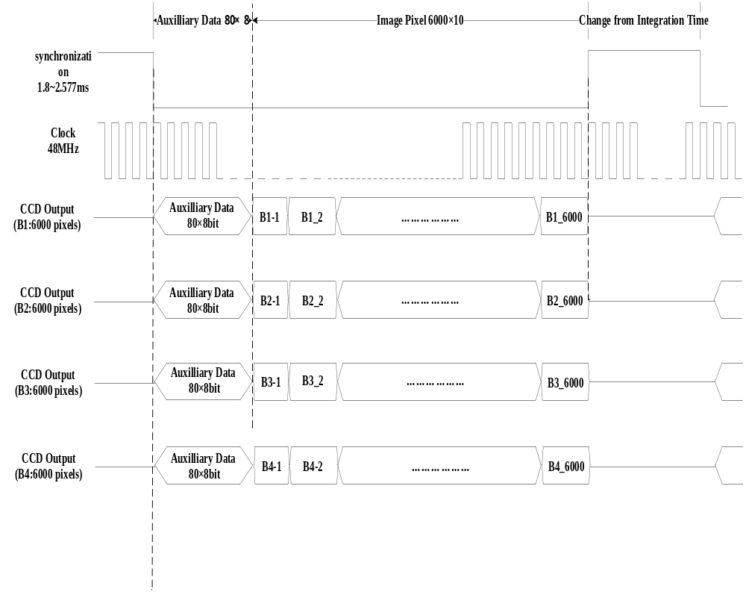
3. Camera Design
3.2 Imaging geometry and pixel order
THIS DOCUMENT CONTAINS PROPRIETARY INFORMATION OF CHINA ACADEMY OF SPACE TECHNOLOGY, AND MAY NOT BE REPRODUCED, COPIED, DISCLOSED, UTILIZED, PLACED OR TRANSMITTED ON INTERNET, IN WHOLE OR IN PART, WITHOUT PRIOR WRITTEN AUTHORIZATION.

Slide 16
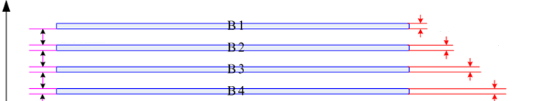
3 How to Use Satellite Data
3.2 Imaging geometry and pixel order
In the light of the principle of individual imaging for 4 bands, the direction of charge transfer is opposite to the flight direction.
Flight direction
Charge transfer
THIS DOCUMENT CONTAINS PROPRIETARY INFORMATION OF CHINA ACADEMY OF SPACE TECHNOLOGY, AND MAY NOT BE REPRODUCED, COPIED, DISCLOSED, UTILIZED, PLACED OR TRANSMITTED ON INTERNET, IN WHOLE OR IN PART, WITHOUT PRIOR WRITTEN AUTHORIZATION.

Slide 17

3.3 Auxiliary data
3 How to Use Satellite Data
Auxiliary data |  |  |  |  |  | Image data region
Header | MS Label | Row counter | Frame counter | Camera parameters | Satellite parameters (10bit) | 1~ 6000 Image data (10bit)
3*10bit | 1*10bit | 3*10bit | 1*10bit | 4*10bit | 68*10bit
bit |  |  |  |  |  | bit
THIS DOCUMENT CONTAINS PROPRIETARY INFORMATION OF CHINA ACADEMY OF SPACE TECHNOLOGY, AND MAY NOT BE REPRODUCED, COPIED, DISCLOSED, UTILIZED, PLACED OR TRANSMITTED ON INTERNET, IN WHOLE OR IN PART, WITHOUT PRIOR WRITTEN AUTHORIZATION.
PAGE <number>
THIS DOCUMENT CONTAINS PROPRIETARY INFORMATION OF CHINA ACADEMY OF SPACE TECHNOLOGY, AND MAY NOT BE REPRODUCED, COPIED, DISCLOSED, UTILIZED, PLACED OR TRANSMITTED ON INTERNET, IN WHOLE OR IN PART, WITHOUT PRIOR WRITTEN AUTHORIZATION.

Slide 18
Auxiliary data format
transformation data format
byte 0 | byte 1 | byte 2 | byte 3 | byte 4～6 | byte 7 | byte 8 | byte 9 | byte 10 | byte 11 | byte 12～79 | byte 80~8079(10bit)
Header |  |  | MS Label | Row counter | Frame counter | Horizontal synchronization counter |  |  |  | Satellite parameters | Image data
FA | F3 | 34 |  |  |  | HW HB | HW LB | LW HB | LW LB
FA | F3 | 34 | B1 | 00H | 00H | Counter value 1 |  |  |  | GPS locating broadcast data W0～W58 Broadcast data of Gyro and attitude W0～W8 | 1~6000pixel data
FA | F3 | 34 | B1 | 01H | 01H | Counter value 2 |  |  |  | Broadcast data of Gyro and attitude W9～W76 | 1~6000pixel data
THIS DOCUMENT CONTAINS PROPRIETARY INFORMATION OF CHINA ACADEMY OF SPACE TECHNOLOGY, AND MAY NOT BE REPRODUCED, COPIED, DISCLOSED, UTILIZED, PLACED OR TRANSMITTED ON INTERNET, IN WHOLE OR IN PART, WITHOUT PRIOR WRITTEN AUTHORIZATION.

Slide 19
Auxiliary data format
transformation data format
FA | F3 | 34 | B1 | 02H | 02H | Counter value 3 | Broadcast data of Gyro and attitude W77～W138 Broadcast data of STS W0～W5 | 1~6000pixel data
FA | F3 | 34 | B1 | 03H | 03H | Counter value 4 | Broadcast data of STS W6～W73 | 1~6000pixel data
FA | F3 | 34 | B1 | 04H | 04H | Counter value 5 | Broadcast data of STS W74～W92 Filling 0 W93～W141 | 1~6000pixel data
FA | F3 | 34 | B1 | 05H | 05H | Counter value 6 | Camera parameters W142～W209 | 1~6000pixel data
FA | F3 | 34 | B1 | 06H | 01H | Counter value 7 | GPS locating broadcast data W0～W58 Broadcast data of Gyro and attitude W0～W8 | 1~6000pixel data
… | … | … | … | … | … | … | … | …
THIS DOCUMENT CONTAINS PROPRIETARY INFORMATION OF CHINA ACADEMY OF SPACE TECHNOLOGY, AND MAY NOT BE REPRODUCED, COPIED, DISCLOSED, UTILIZED, PLACED OR TRANSMITTED ON INTERNET, IN WHOLE OR IN PART, WITHOUT PRIOR WRITTEN AUTHORIZATION.

Slide 20
3 How to Use Satellite Data
3.3 How to use auxiliary data
1) Standard time data
Standard time data will be broadcasted on the CAN bus 50ms after Data Handling Subsystem send second pulse. The period of broadcasting is 1s.
THIS DOCUMENT CONTAINS PROPRIETARY INFORMATION OF CHINA ACADEMY OF SPACE TECHNOLOGY, AND MAY NOT BE REPRODUCED, COPIED, DISCLOSED, UTILIZED, PLACED OR TRANSMITTED ON INTERNET, IN WHOLE OR IN PART, WITHOUT PRIOR WRITTEN AUTHORIZATION.

Slide 21
3 How to Use Satellite Data
3.3 How to use auxiliary data
2) GPS position data
GPS position data includes the phase center of the carrier of GPS antenna measured by GPS receiver at specific UTC time, flight speed and integration time of the camera at this time. The period of broadcasting is 1s.
UTC time: accumulative seconds of UTC from zero o’clock, 1st Jan. 2009 (UTC Greenwich zone)
position: the X, Y, Z coordinates of WGS84;
speed: the speed vector of the X, Y, Z coordinates of WGS84;
integration time: the time code executed by the camera;
THIS DOCUMENT CONTAINS PROPRIETARY INFORMATION OF CHINA ACADEMY OF SPACE TECHNOLOGY, AND MAY NOT BE REPRODUCED, COPIED, DISCLOSED, UTILIZED, PLACED OR TRANSMITTED ON INTERNET, IN WHOLE OR IN PART, WITHOUT PRIOR WRITTEN AUTHORIZATION.

Slide 22
3 How to Use Satellite Data
3.3 How to use auxiliary data
3) Broadcast data of STS
Broadcast data of STS are broadcasted by Attitude and Orbit Control Subsystem and can be switched to use by the command. Their period of broadcasting are all 1s.
Item | Description
Broadcast data of STS | the quaternion of the satellite attitude; 12 group measurement data of three star sensor;
THIS DOCUMENT CONTAINS PROPRIETARY INFORMATION OF CHINA ACADEMY OF SPACE TECHNOLOGY, AND MAY NOT BE REPRODUCED, COPIED, DISCLOSED, UTILIZED, PLACED OR TRANSMITTED ON INTERNET, IN WHOLE OR IN PART, WITHOUT PRIOR WRITTEN AUTHORIZATION.

Slide 23
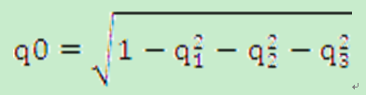
3 How to Use Satellite Data
3.3 How to use auxiliary data
3) Broadcast data of STS
The using method of Broadcast data of STS are given as bellow:
time label: the measurement time of attitude data, 6 byte size, microsecond;
quaternion: only q1, q2, q3 are provided. q0 can be obtained by the following equation
THIS DOCUMENT CONTAINS PROPRIETARY INFORMATION OF CHINA ACADEMY OF SPACE TECHNOLOGY, AND MAY NOT BE REPRODUCED, COPIED, DISCLOSED, UTILIZED, PLACED OR TRANSMITTED ON INTERNET, IN WHOLE OR IN PART, WITHOUT PRIOR WRITTEN AUTHORIZATION.

Slide 24
3 How to Use Satellite Data
3.3 How to use auxiliary data
4) Broadcast data of Gyro and attitude
Broadcast data of Gyro and attitude provides the angular velocity of the satellite attitude, which represents the component of the coordinates of the satellite itself relative to the inertial coordinates, measured by the gyros.
The period of broadcasting is 1s. There are totally 4 groups measurement data of the gyros, whose control period of control computer is same with the 12 groups data of Broadcast data of STS at the acquisition frequency of 1s.
time label: the measurement time, 4 byte size, microsecond;
data : the angular velocity of roll (X axis), pitch (Y axis), yaw (Z axis) directions in the coordinates of the satellite itself relative to the inertial coordinates.
THIS DOCUMENT CONTAINS PROPRIETARY INFORMATION OF CHINA ACADEMY OF SPACE TECHNOLOGY, AND MAY NOT BE REPRODUCED, COPIED, DISCLOSED, UTILIZED, PLACED OR TRANSMITTED ON INTERNET, IN WHOLE OR IN PART, WITHOUT PRIOR WRITTEN AUTHORIZATION.

Slide 25
3 How to Use Satellite Data
3.3 How to use auxiliary data
5) Integration time code of CCD
The integration time code of 8 Bytes size, represents the integration time code of CCD.
The computation equation between the integration time and the integration time code is as bellow: from 1.8ms (0001H) to 2.5ms
where Tint (ms) is the integration time, CODE is the integration time code of PAN, DEC2HEX ( ) function can convert data from the decade system to the hex system.
THIS DOCUMENT CONTAINS PROPRIETARY INFORMATION OF CHINA ACADEMY OF SPACE TECHNOLOGY, AND MAY NOT BE REPRODUCED, COPIED, DISCLOSED, UTILIZED, PLACED OR TRANSMITTED ON INTERNET, IN WHOLE OR IN PART, WITHOUT PRIOR WRITTEN AUTHORIZATION.

Slide 26
3 How to Use Satellite Data
3.3 How to use auxiliary data
6) Time of exposure
The high-precision timing system works as the following flow:
a) the local clock works with the frequency of 1MHz;
b) when GPS second pulse comes, the camera locks the local clock and generates a count value N0 which is saved in the auxiliary;
c) when the camera produce one image line, the camera locks the local clock again and generates a count value Ni which is also saved in the auxiliary.
THIS DOCUMENT CONTAINS PROPRIETARY INFORMATION OF CHINA ACADEMY OF SPACE TECHNOLOGY, AND MAY NOT BE REPRODUCED, COPIED, DISCLOSED, UTILIZED, PLACED OR TRANSMITTED ON INTERNET, IN WHOLE OR IN PART, WITHOUT PRIOR WRITTEN AUTHORIZATION.

Slide 27


3 How to Use Satellite Data
3.3 How to use auxiliary data
6) Time of exposure
d) the relative imaging time of every image line t2 can be figured out by the following equation:
e) the time of exposure can be computed by the following equation:
where Tn represents the time of GPS second pulse, t1 is the time delay after the camera receives the GPS second pulse. It can be tested during the development of the satellite;
THIS DOCUMENT CONTAINS PROPRIETARY INFORMATION OF CHINA ACADEMY OF SPACE TECHNOLOGY, AND MAY NOT BE REPRODUCED, COPIED, DISCLOSED, UTILIZED, PLACED OR TRANSMITTED ON INTERNET, IN WHOLE OR IN PART, WITHOUT PRIOR WRITTEN AUTHORIZATION.

Slide 28
3 How to Use Satellite Data
3.3 How to use auxiliary data
7) Integrity of auxiliary data
The camera fills Broadcast data of STS and Broadcast data of Gyro and attitude into the auxiliary which is downloaded to the ground. Please note:
There totally needs 6 lines for 12 groups of Broadcast data of STS while 6 lines for 12 groups of Broadcast data of Gyro and attitude.
THIS DOCUMENT CONTAINS PROPRIETARY INFORMATION OF CHINA ACADEMY OF SPACE TECHNOLOGY, AND MAY NOT BE REPRODUCED, COPIED, DISCLOSED, UTILIZED, PLACED OR TRANSMITTED ON INTERNET, IN WHOLE OR IN PART, WITHOUT PRIOR WRITTEN AUTHORIZATION.

Slide 29
3 How to Use Satellite Data
3.3 How to use storage data of DHS
In the storage data of Data Handling Subsystem (DHS), standard time data, GPS position data fills Broadcast data of STS and Broadcast data of Gyro and attitude has been explained in above subsection.
THIS DOCUMENT CONTAINS PROPRIETARY INFORMATION OF CHINA ACADEMY OF SPACE TECHNOLOGY, AND MAY NOT BE REPRODUCED, COPIED, DISCLOSED, UTILIZED, PLACED OR TRANSMITTED ON INTERNET, IN WHOLE OR IN PART, WITHOUT PRIOR WRITTEN AUTHORIZATION.

Slide 30
TEST
Q1： The ground system can communicate with satellite via _____.
Q2: Downlink rate is _____.
Q3:_____ pixels for multispectral CCD
Q4:How many Bytes in the auxiliary data?
A48 B 96 C 24 D60
THIS DOCUMENT CONTAINS PROPRIETARY INFORMATION OF CHINA ACADEMY OF SPACE TECHNOLOGY, AND MAY NOT BE REPRODUCED, COPIED, DISCLOSED, UTILIZED, PLACED OR TRANSMITTED ON INTERNET, IN WHOLE OR IN PART, WITHOUT PRIOR WRITTEN AUTHORIZATION.

Slide 31

The End !

